Slide 1
DATA ANALYSIS - CUSTOMER RETENTION DATASET

Slide 2
ROADMAP
DATA CLEANING
DATA WRANGLING
DATA ANLYSIS & OBSERVATION
1
3
5
2
4
DATA HANDLING
DATA TRANSFORMATION

Slide 3
INITIAL DATA CLEANING WITH TEST & TRAIN DATA
Data.shape
Finding out the shape of the data with this function.
Categorical columns
Separated the categorical columns and viewed their sub options with - dtype == 'object’ and value count function
Checked for nulls
Checked for nulls with - df.isnull().sum()
Checked for any blank spaces , added mode and mean method
Checked for spaces in data with- df.replace(' ', np.NaN) function. Used mode and mean to balance data
Checked for unique values in numerical data
Separated the categorical columns and viewed their sub options with - dtype == ‘int64’ and ‘float’ and value count function
Removed outliers
Df_train.skew method used to remove outliers and check them as per rank.

Slide 4
DATA ANALYSIS-DATA MANIPULATION/WRANGLING
Label Encoding
Converted categorical data into numerical to plot graphs, transform dataand scale with Satandard Scalar
Correlation
Found correlation between features with corr() function & correlation matrix
Separated year columns vs Sales price
Compared object data type with Sales Price as well as compared numerical columns with target column i.e. Sales price separately
Displayed skewness for numerical & categorical date
Following columns were found to be skewed - MiscVal , PoolArea, condition2, LotArea, Heating, GarageCond, SaleType, Functional, PoolQc, Street

Slide 5
DATA TRANSFORMATION
RELATIONS AS PER CORR MATRIX
BldgType and MSSubClass
overallQual n SalePrice
SalePrice and GrLivArea
GrLivArea n OverallQual
TotRmsAbvGrd vs GrLivArea
GarageCars vs GarageArea
GrLivArea vs SalePrice
GrLivArea vs totrmsabvgrd
TotalBsmtSF vs 1stFlrSF
STANDARD SCALAR
Used standard scalar method to scale the data and remove any outliers.
We would be using this step for fruitful feature reduction as there are 80 features.
CHI and PRECENTILE METHOD
As there are 80 features, it will impact the accuracy of the model. We need to select the top features for further steps while creating a model.
We have used chi score as a feature reduction method
After treating the data, there are only 80% features that are required to handle data out of

Slide 6
OBSERVATIONS
Sales Price and OverallQual(Rates the overall material and finish of the house) : Sales price is highest for 9-10 (10 stands for excellent)
Sales Price vs OverallCond(Rates the overall condition of the house): The sales price is highest for 5, which is average
Sales Price vs Functional : Typ fetches the highest sales price
Sales Price vs GarageQual: TA fetches the highest sales price
Sales Price vs Paved Drive: Paved fetches the highest sales price
Sales Price vs Sales Type: WD(Warranty Deed – Conventional) fetches the highest sales price
Sales Price vs Sales Condition: The normal and partial category fetches the highest sales price
Sales Price vs MoSold(month sold): The ‘7th ’ category month has the highest sales price
Sales Price vs GrLivArea(Above grade (ground) living area square feet )- majority of the basement area available is between 1000-2000 sqft and costs between 100000-300000

Slide 7
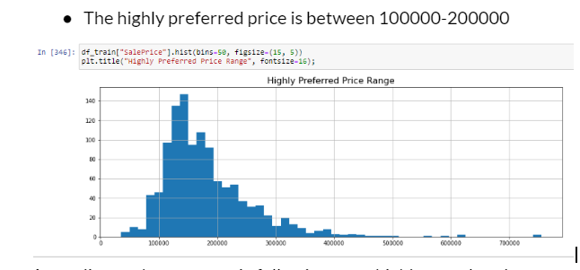
OBSERVATIONS
Following algorithms used for the training and testing:
Random Forest
Decision Tree
Ada Boost
Linear regression
Random Forest was selected.
Did not perform hyper tuning as high score was there
Linear regression: 82%
Random Forest – 97%
Adaboost-87%

Slide 8
THANKS!

